Slide 1


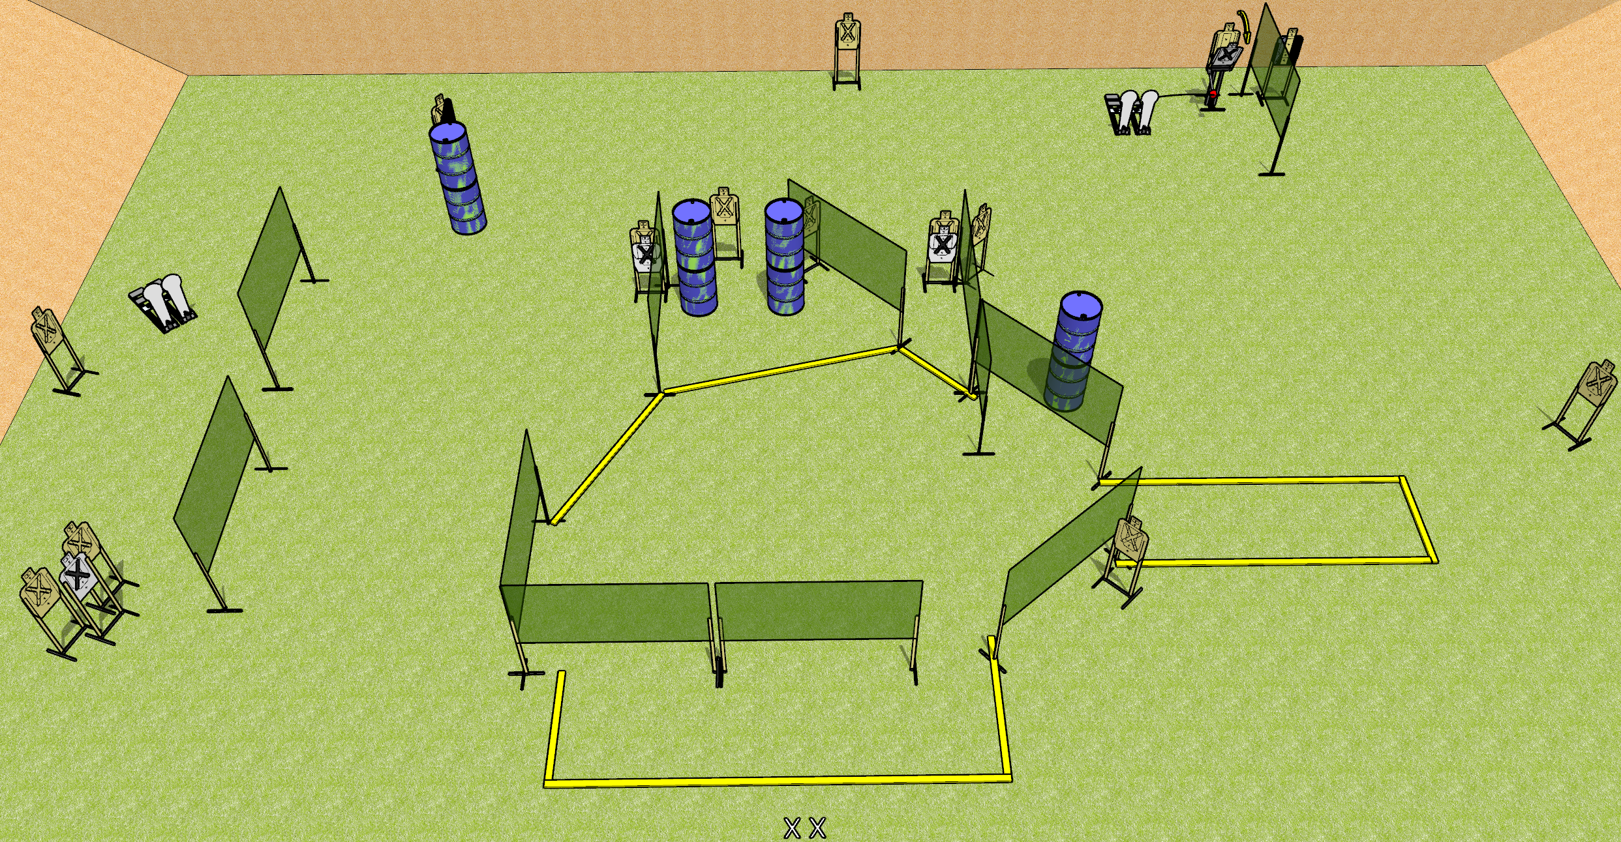
 | Dothan Gun Club – USPSA Match Quack! Course Designer : Drew Coleman
START POSITION : Standing with both feet on X’s, wrists below belt
GUN READY CONDITION : Pistol loaded and holstered. PCC loaded, held with both hands, shouldered, safety on, pointed at orange cone. |  | SCORING: Comstock, 32 rounds TARGETS: 14 paper, 4 Steel SCORED HITS: Best 2 on paper, steel until down START-STOP: Audible, last shot RULES:
STAGE PROCEDURE: Engage targets as they become available from within the fault lines.

Slide 2
Quack!
Written Stage Briefing
Quack! is a 32 round, 160 point, Comstock field course. There are fourteen USPSA targets and four Colt poppers. The best two hits on paper will score and steel must fall to score. The start signal is audible.
The right Colt popper will activate the Max trap. Please examine the activator prior to first shooter and set it up the same way each time.
Handgun start position is standing with both feet on X’s, wrists below belt. Pistol is loaded and holstered.
PCC start position is standing with both feet on X’s, muzzle pointed at orange cone. Loaded carbine is held with both hands, shouldered, safety on.
On start signal, engage targets as they become available from within the shooting area.

